Slide 1
The Tool You Never Knew You Needed
An Introduction to Application Insights

Slide 2



Isaac Levin Application Development Manager – Microsoft Developer Support
</> https://www.isaaclevin.com
@isaac2004
@isaac2004

Slide 3
Quick Poll
Who writes Web Apps (client,server,both)?
Who has apps deployed to the cloud? On-Prem?
Who uses an APM (New Relic, App Dynamics)?
Who rolls own Telemetry Collection (NLog, log4net)?
Who knows/uses Application Insights?
Telemetry?

Slide 4
Questions To Consider
What could we do with all the data our application creates/uses?
How much easier would our lives be if we could chart the path of a request frequently used and spend little time doing it?
Which kinds of reports regarding usage would our stakeholders most benefit from?

Slide 5

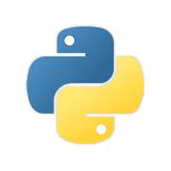

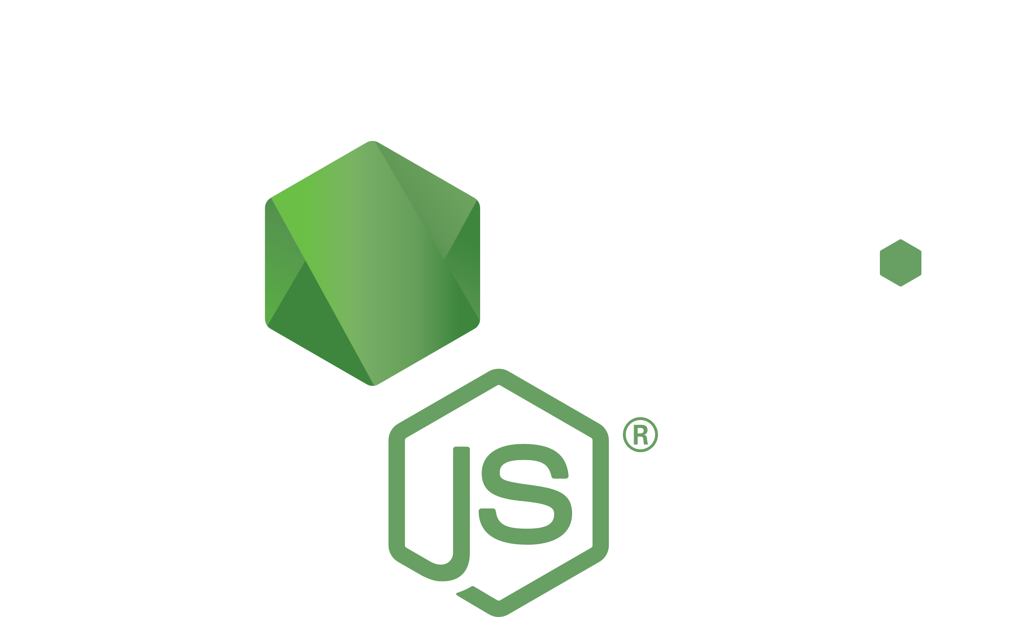

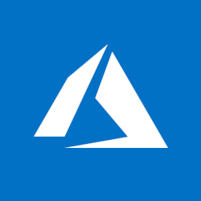



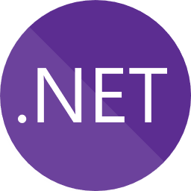
What is App Insights?
Notes:
Application Insights is an extensible Application Performance Management (APM) service for web developers on multiple platforms. Use it to monitor your live web application. It will automatically detect performance anomalies. It includes powerful analytics tools to help you diagnose issues and to understand what users actually do with your app. It's designed to help you continuously improve performance and usability. It works for apps on a wide variety of platforms including .NET, Node.js and J2EE, hosted on-premises or in the cloud. It integrates with your DevOps process, and has connection points to a variety of development tools. It can monitor and analyze telemetry from mobile apps by integrating with Visual Studio App Center and HockeyApp.

Slide 6
What Kind of Telemetry?
Request/Response Information
Dependencies (SQL, 3rd Parties)
Page Views/Load
User Information
Exceptions
Everything Else

Slide 7
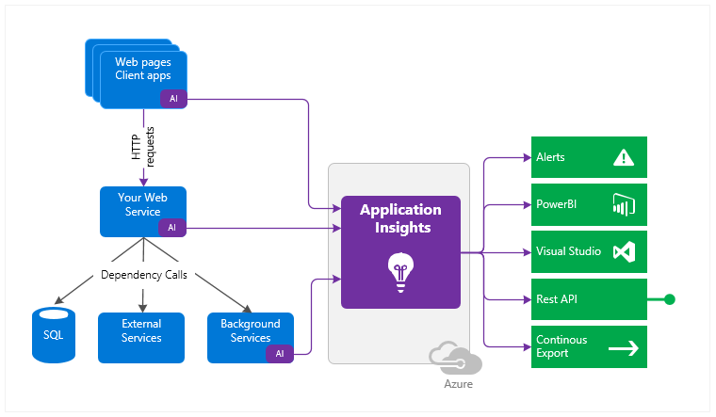
Flow of Application Insights
Notes:
You install a small instrumentation package in your application, and set up an Application Insights resource in the Microsoft Azure portal. The instrumentation monitors your app and sends telemetry data to the portal. (The application can run anywhere - it doesn't have to be hosted in Azure.)
You can instrument not only the web service application, but also any background components, and the JavaScript in the web pages themselves.
In addition, you can pull in telemetry from the host environments such as performance counters, Azure diagnostics, or Docker logs. You can also set up web tests that periodically send synthetic requests to your web service.+
All these telemetry streams are integrated in the Azure portal, where you can apply powerful analytic and search tools to the raw data.

Slide 8
How do I Instrument?

Slide 9
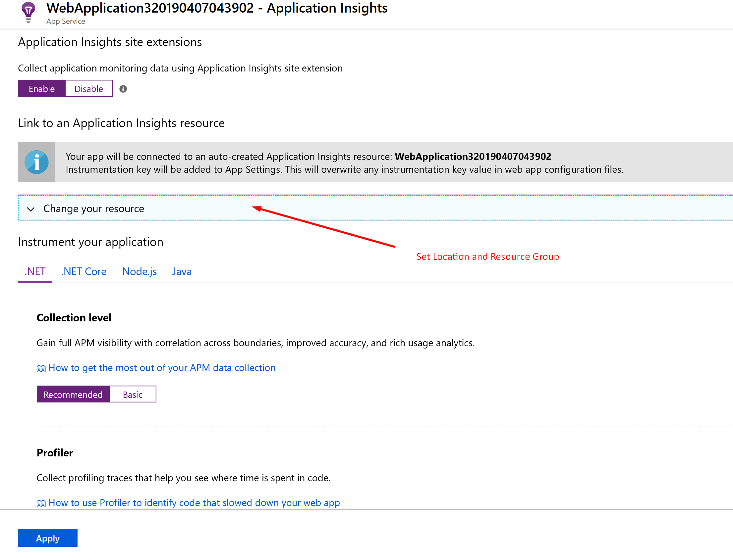
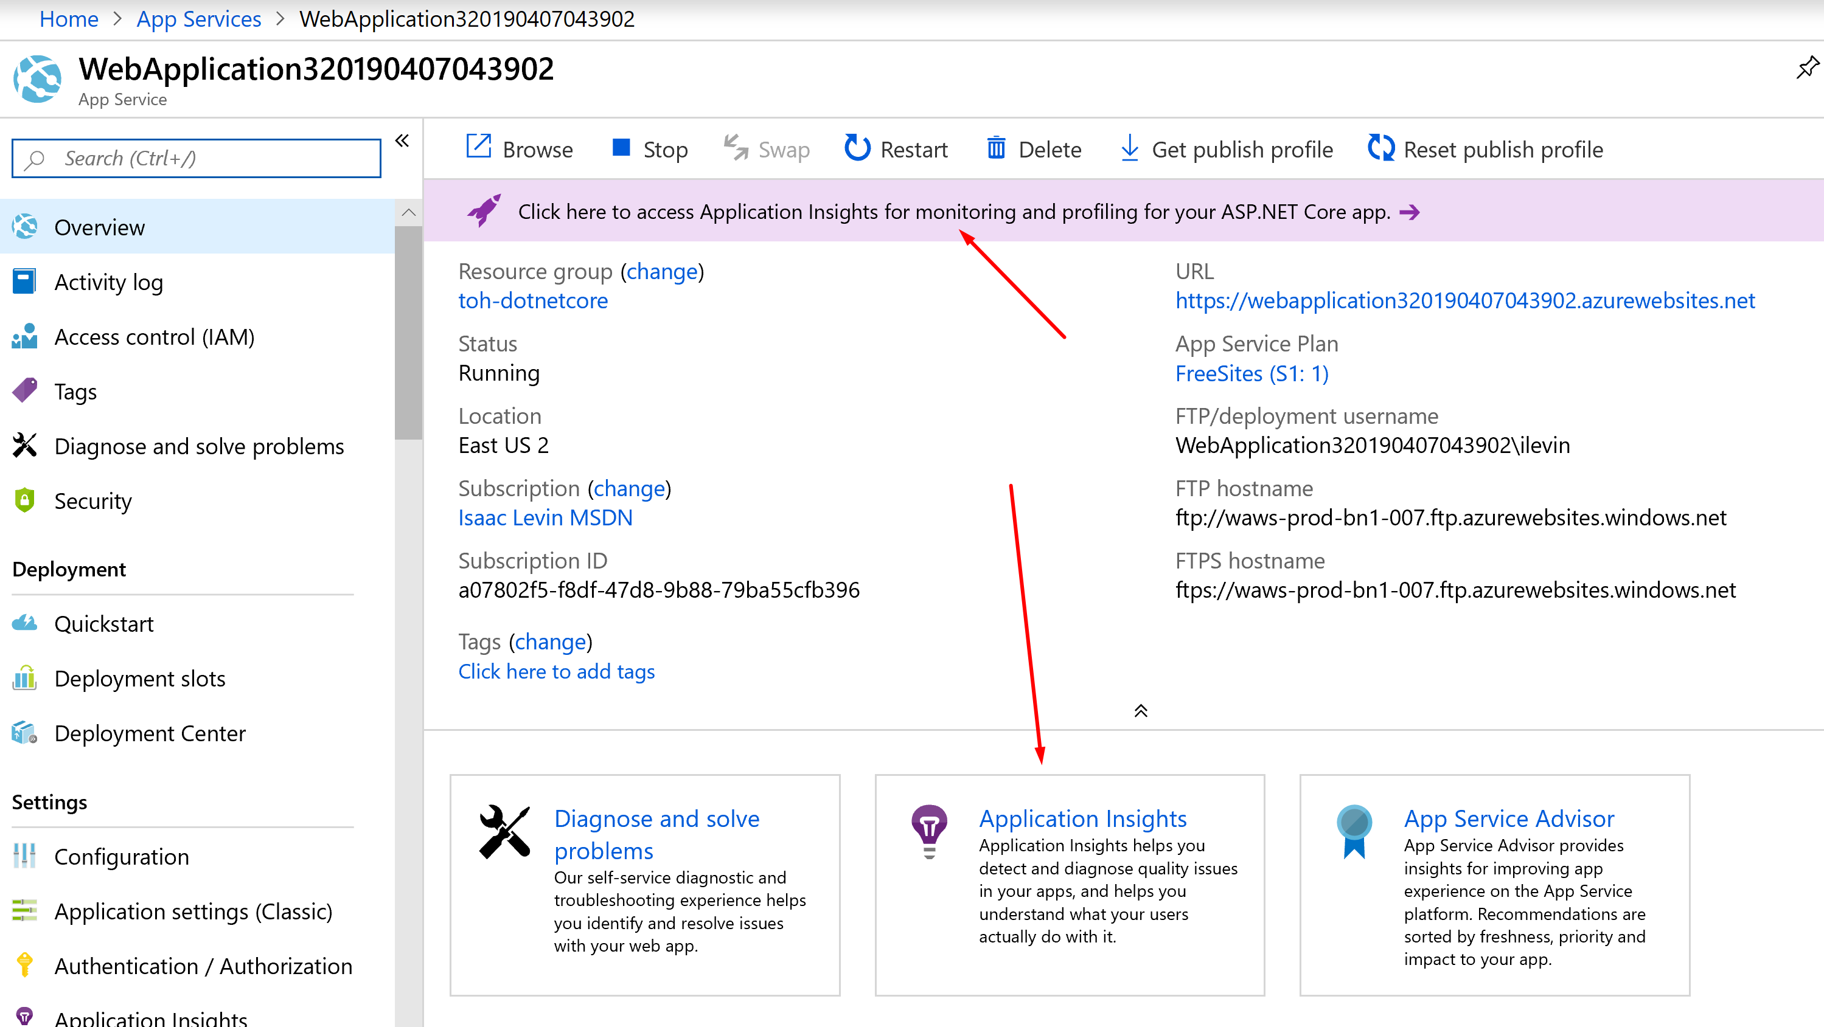
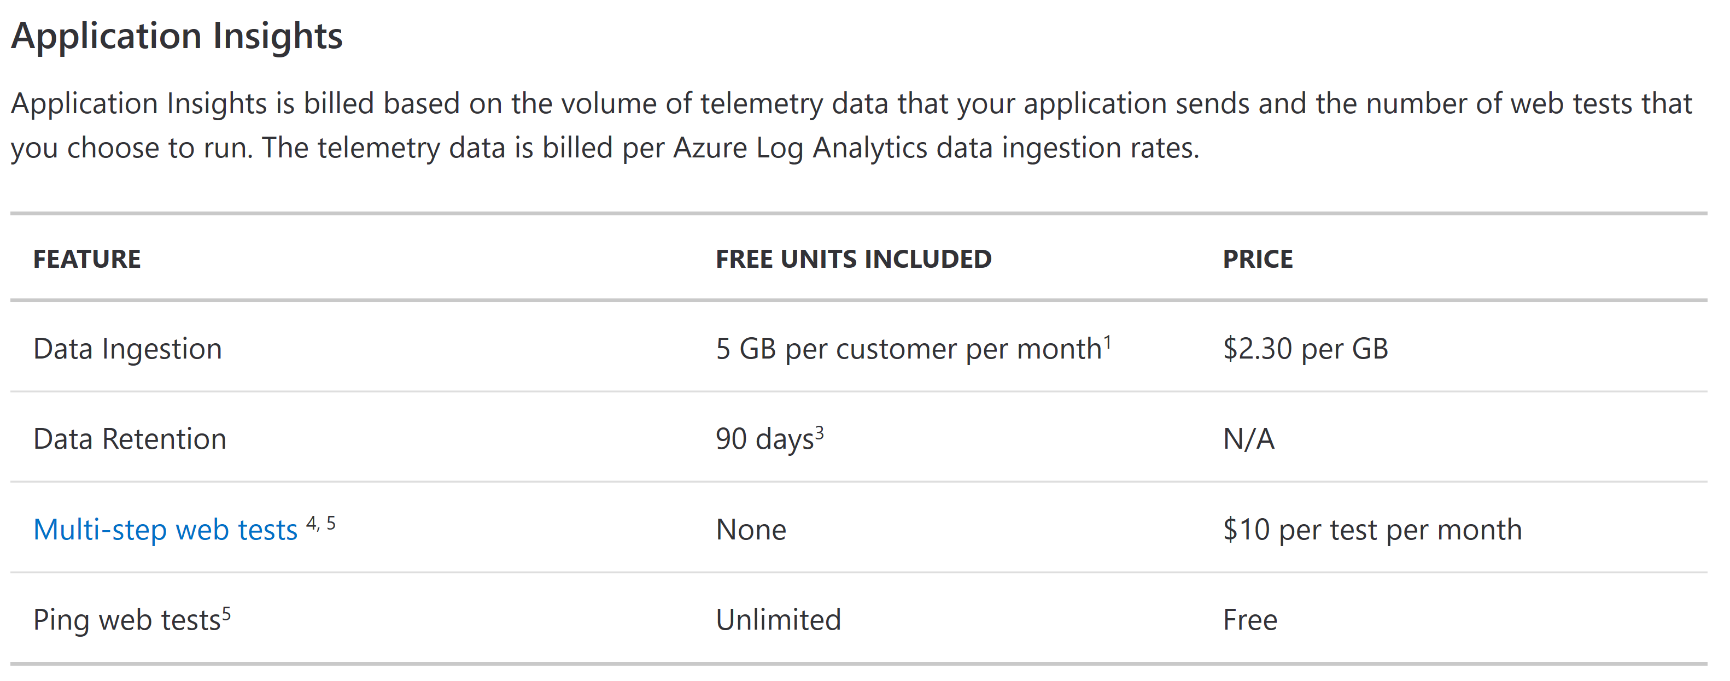
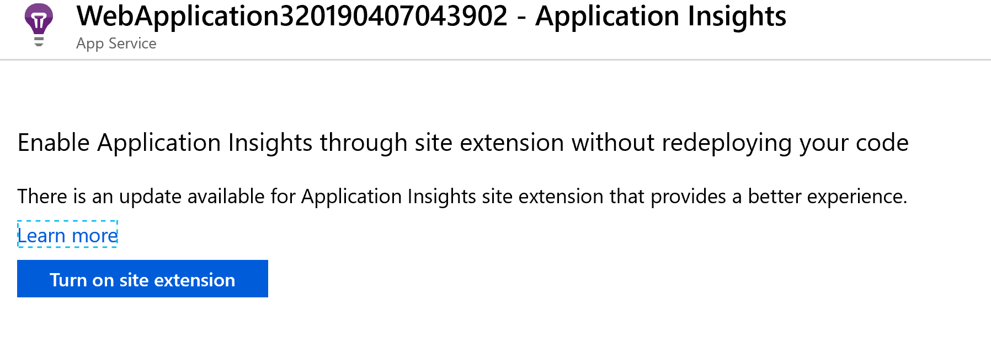
Setting Up Your App
Application Insights Status Monitor (for IIS Servers like on-prem)
Enable Extension on App Service Directly

Slide 10
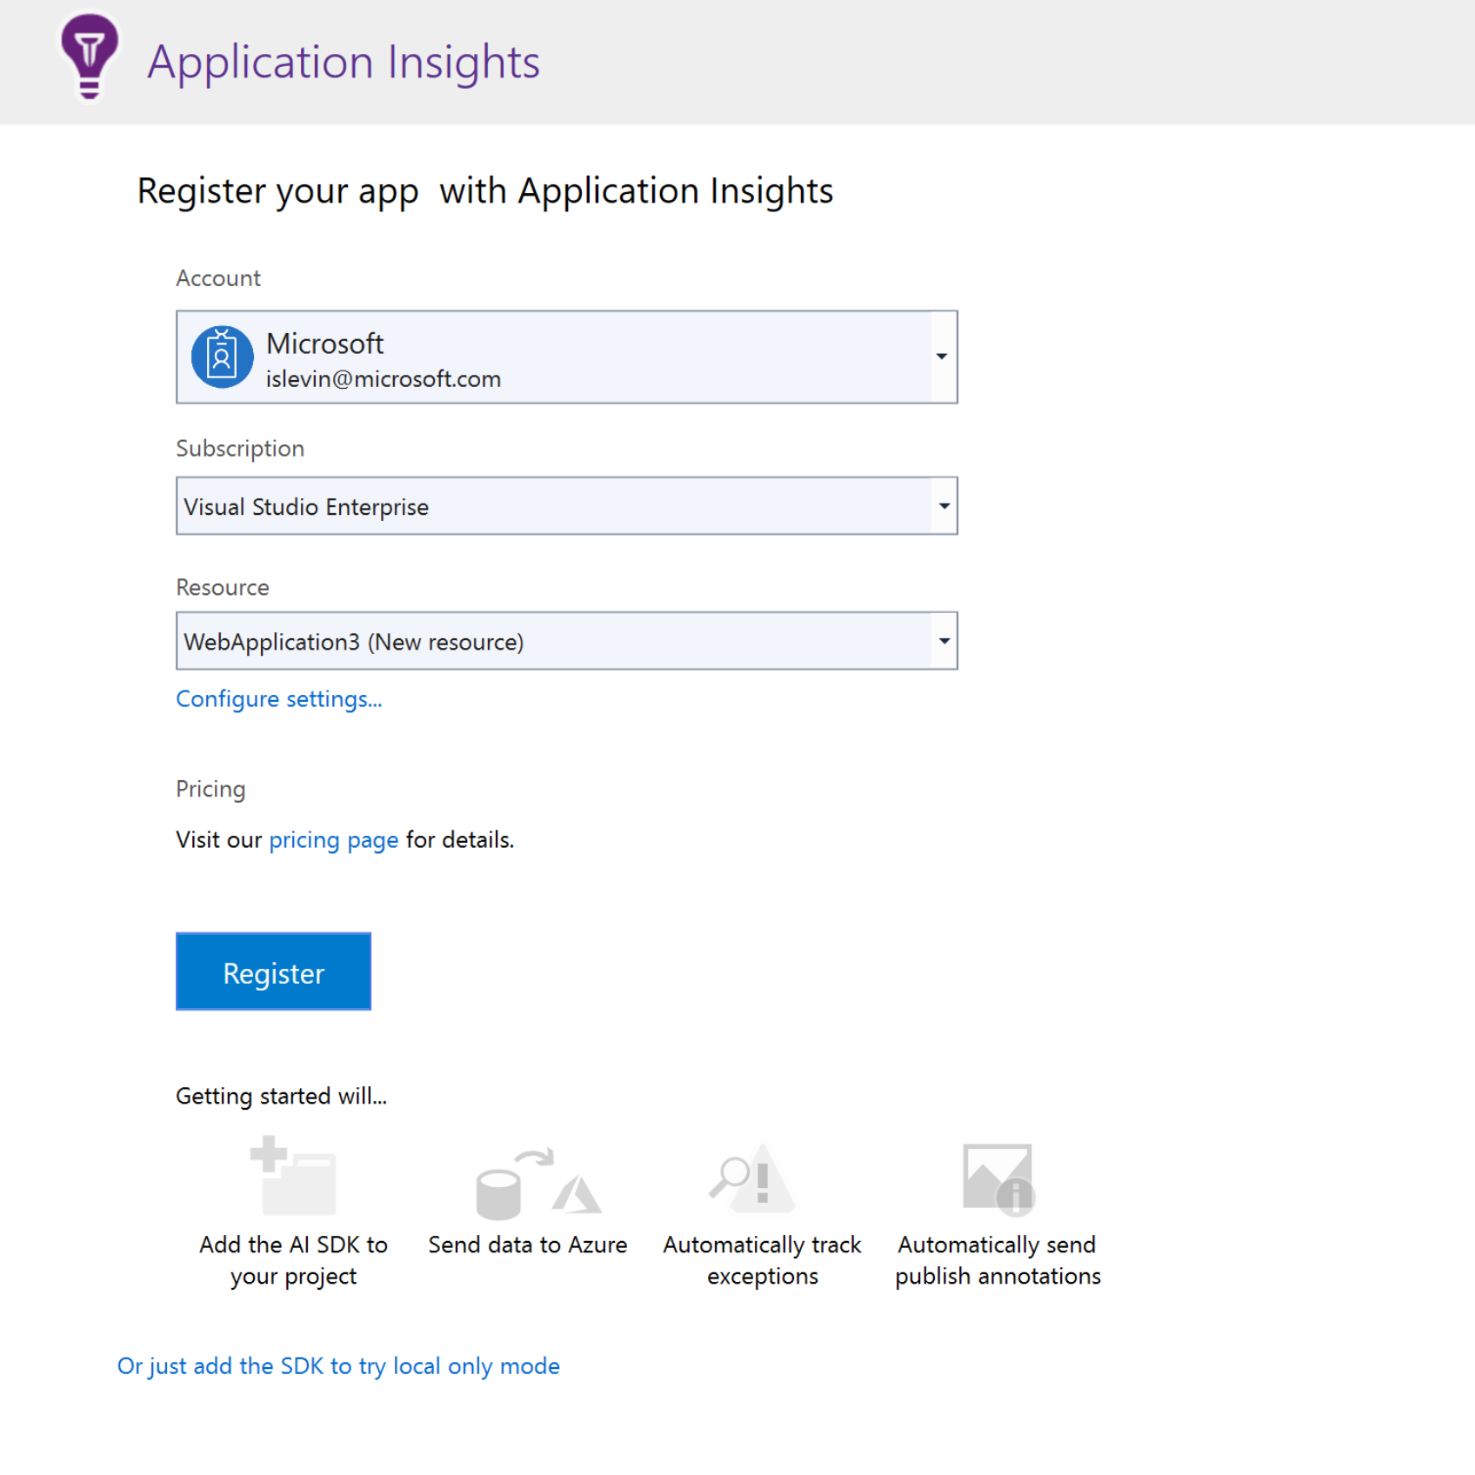
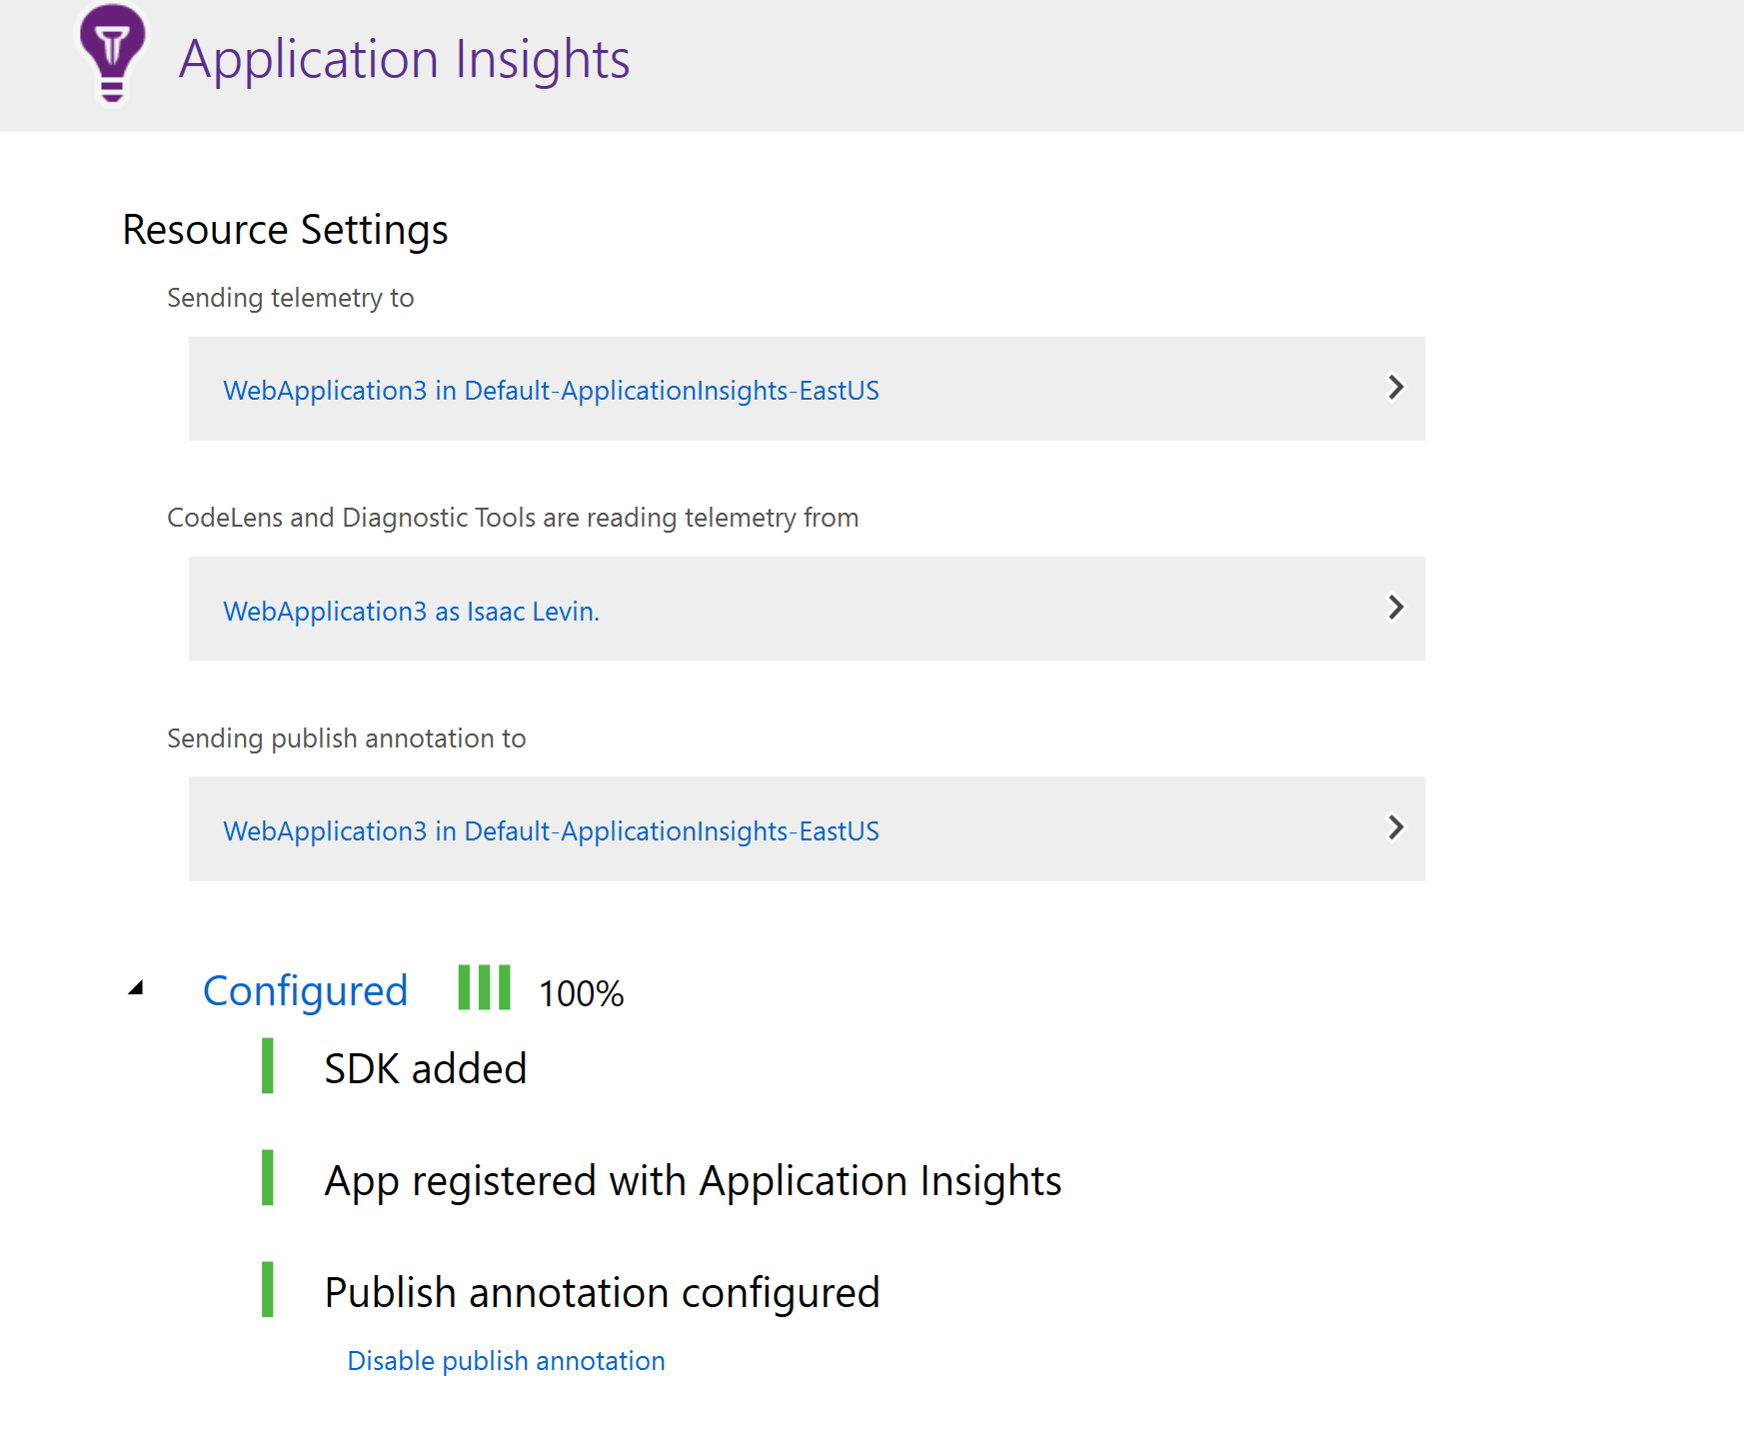
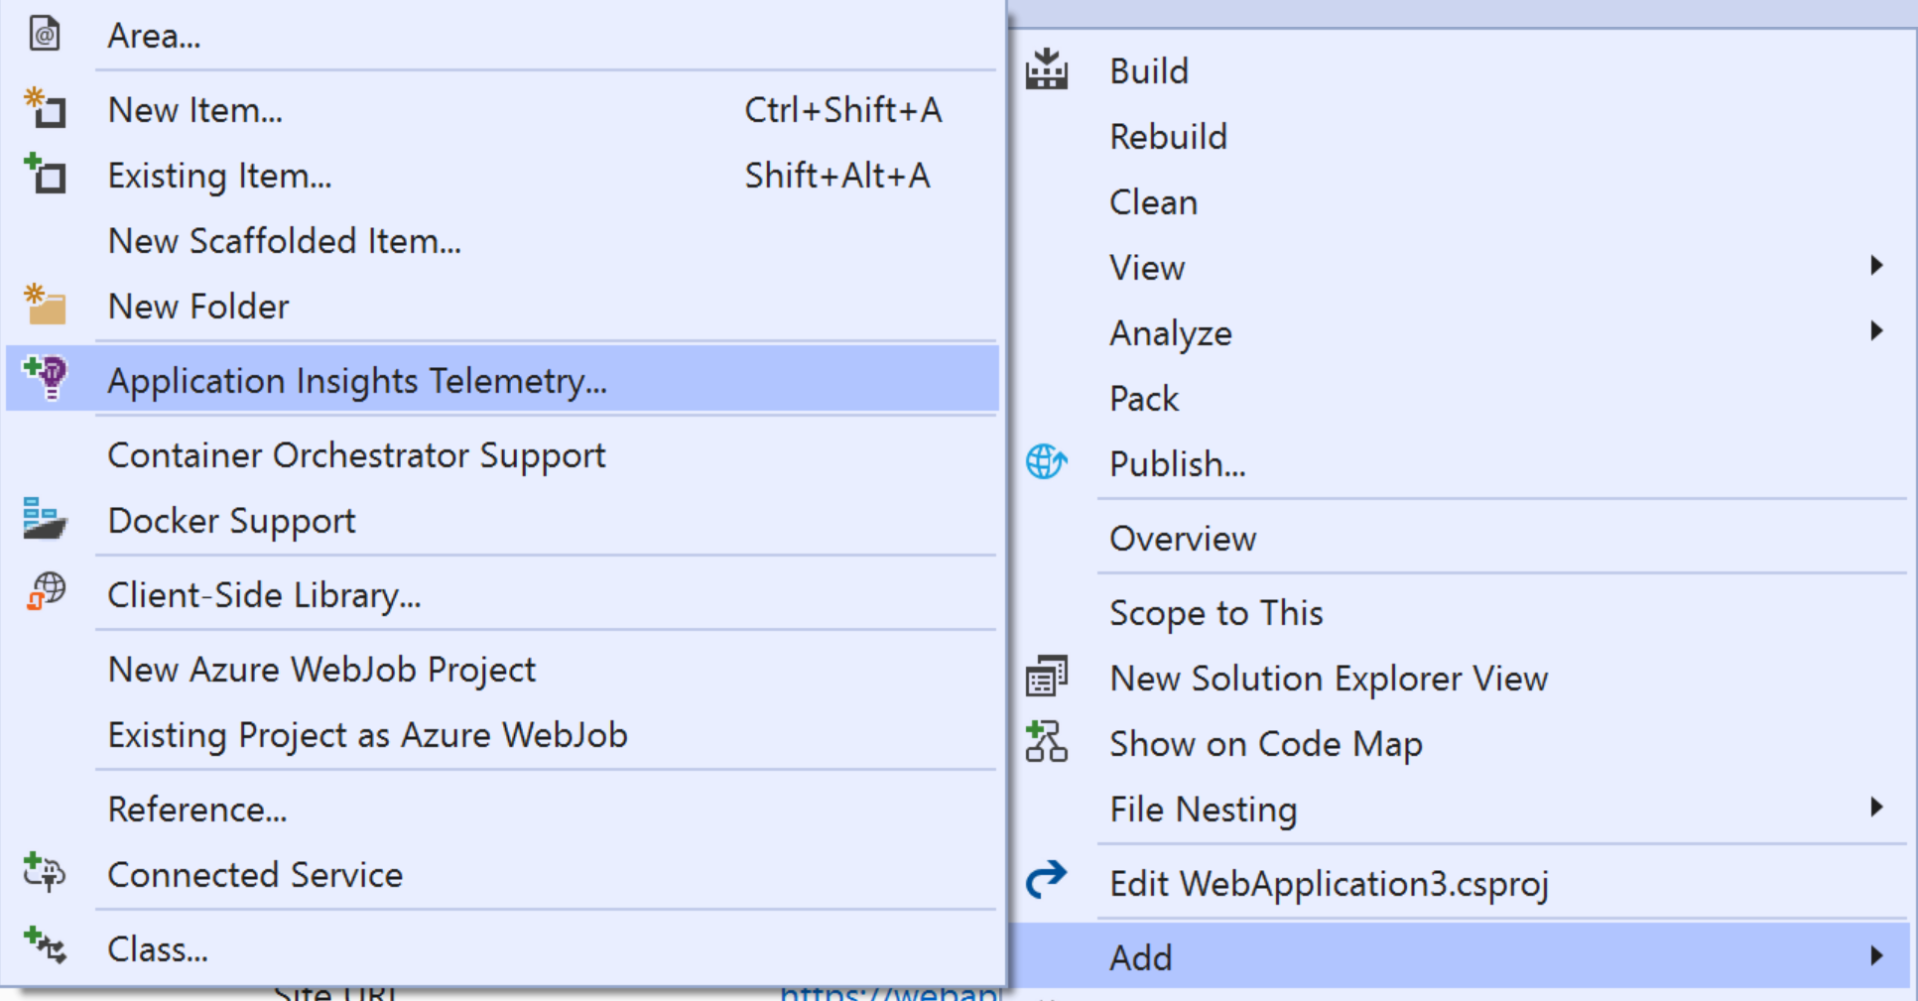
Setting Up Your App
Application Insights Status Monitor (for IIS Servers like on-prem)
Configure Using Visual Studio

Slide 11
Setting Up Your App
Application Insights Status Monitor
PowerShell Module
Codeless Instrumentation of .NET Web Apps hosted in IIS
API commands to “turn on “features”
Application Insights Status Monitor (for IIS Servers like on-prem)
What about IIS?

Slide 12
Setting up App Insights
Demo

Slide 13
What do I do with this data?

Slide 14
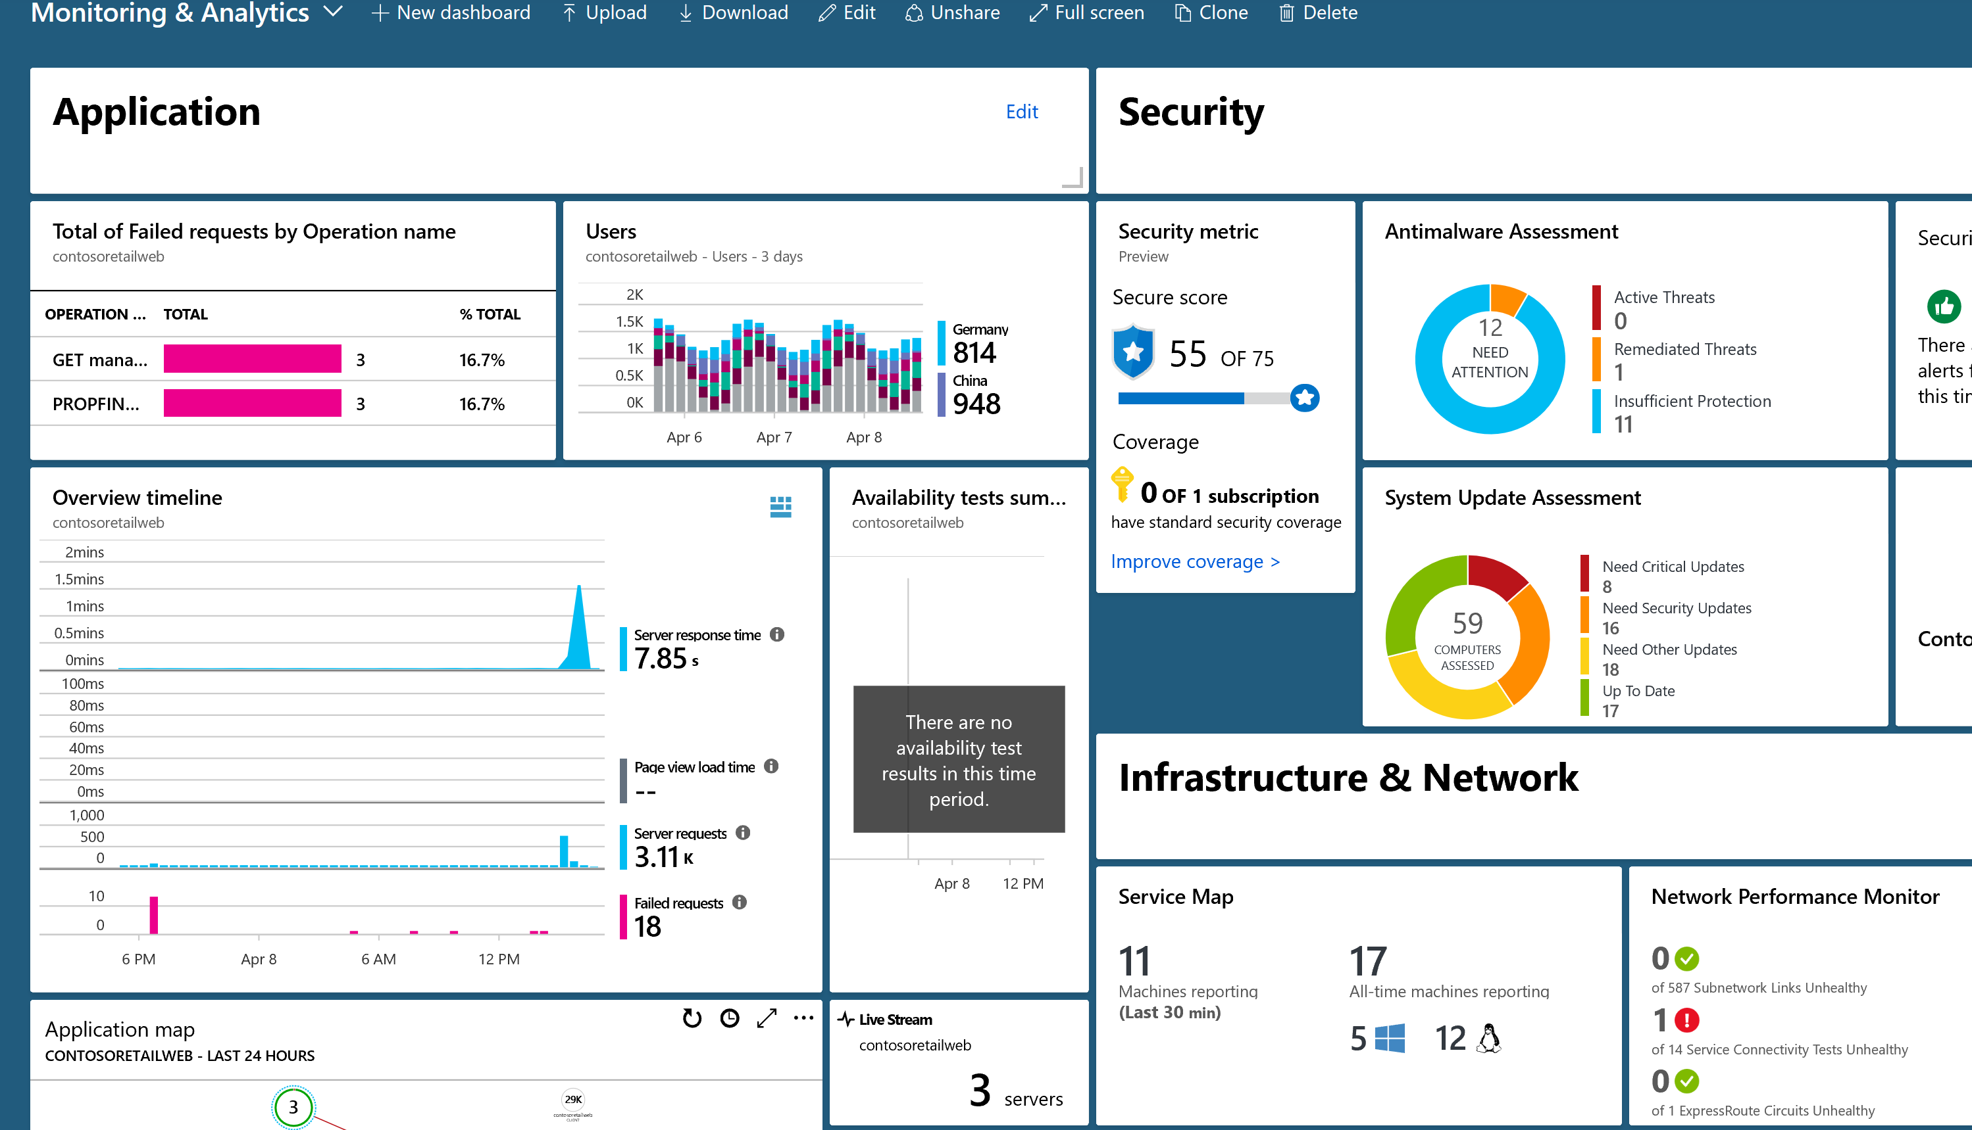
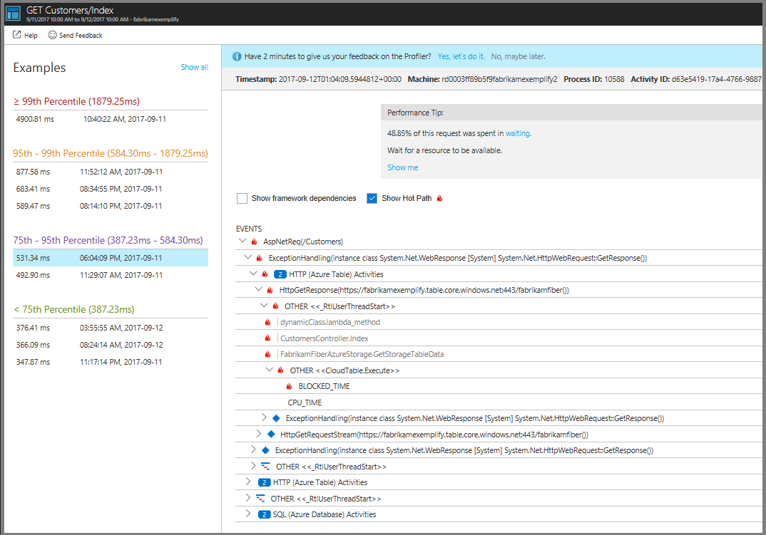
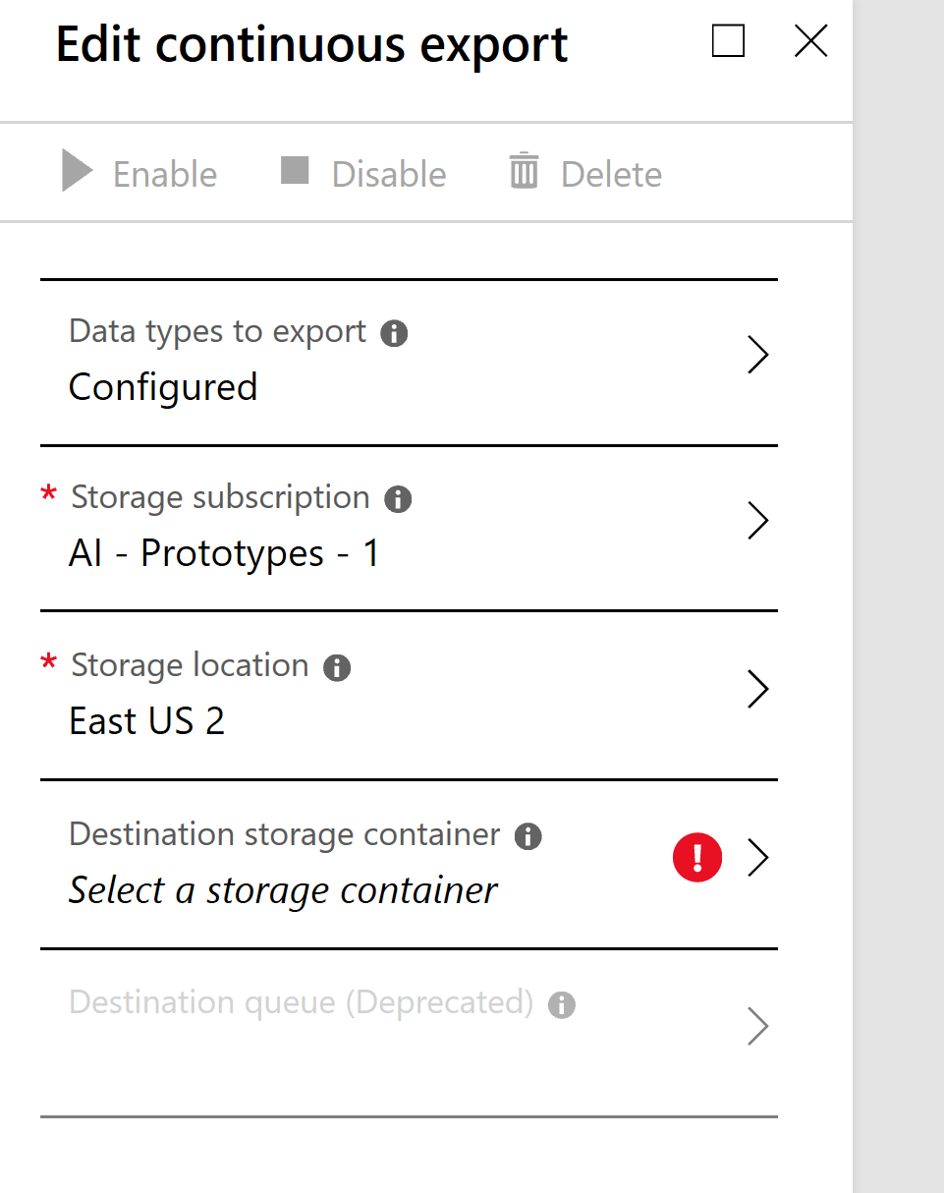
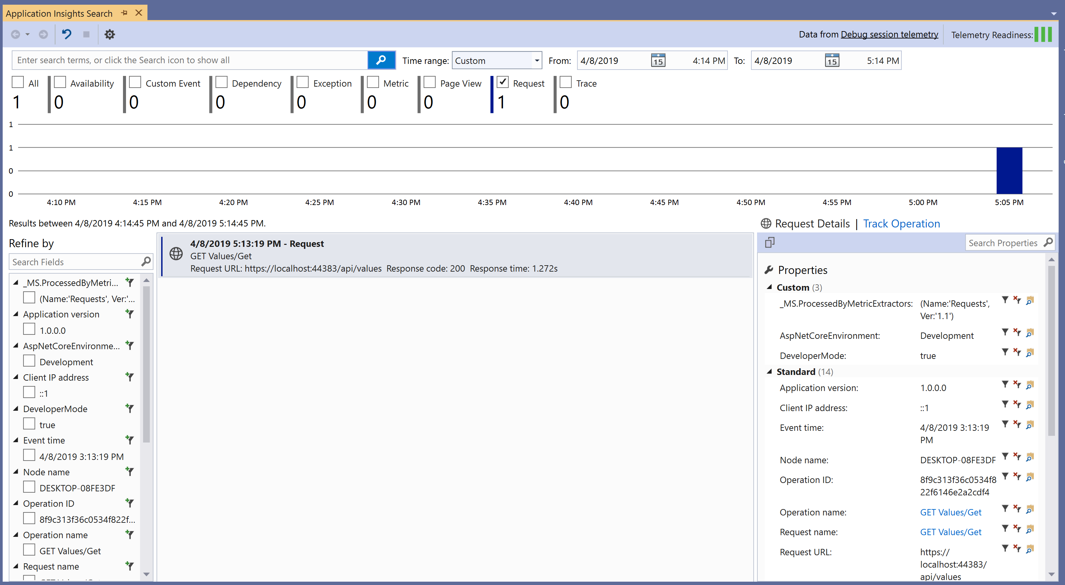
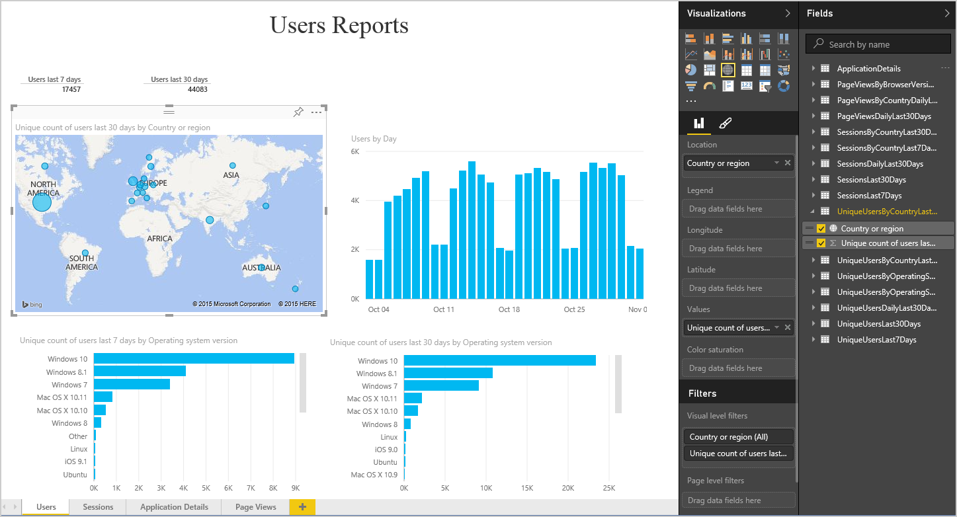
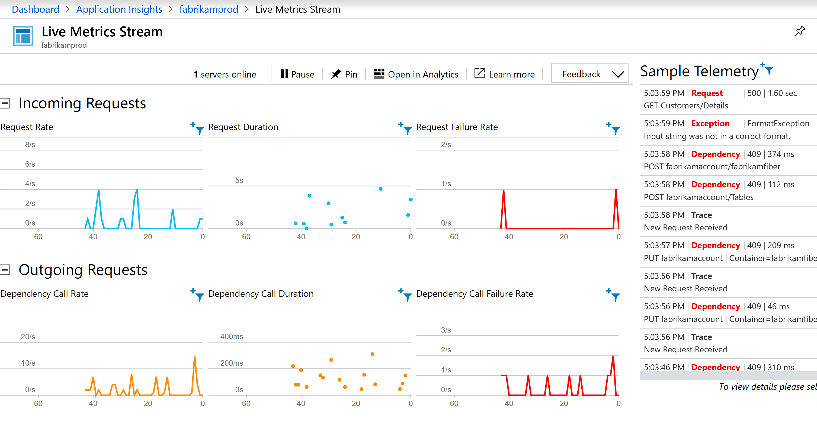
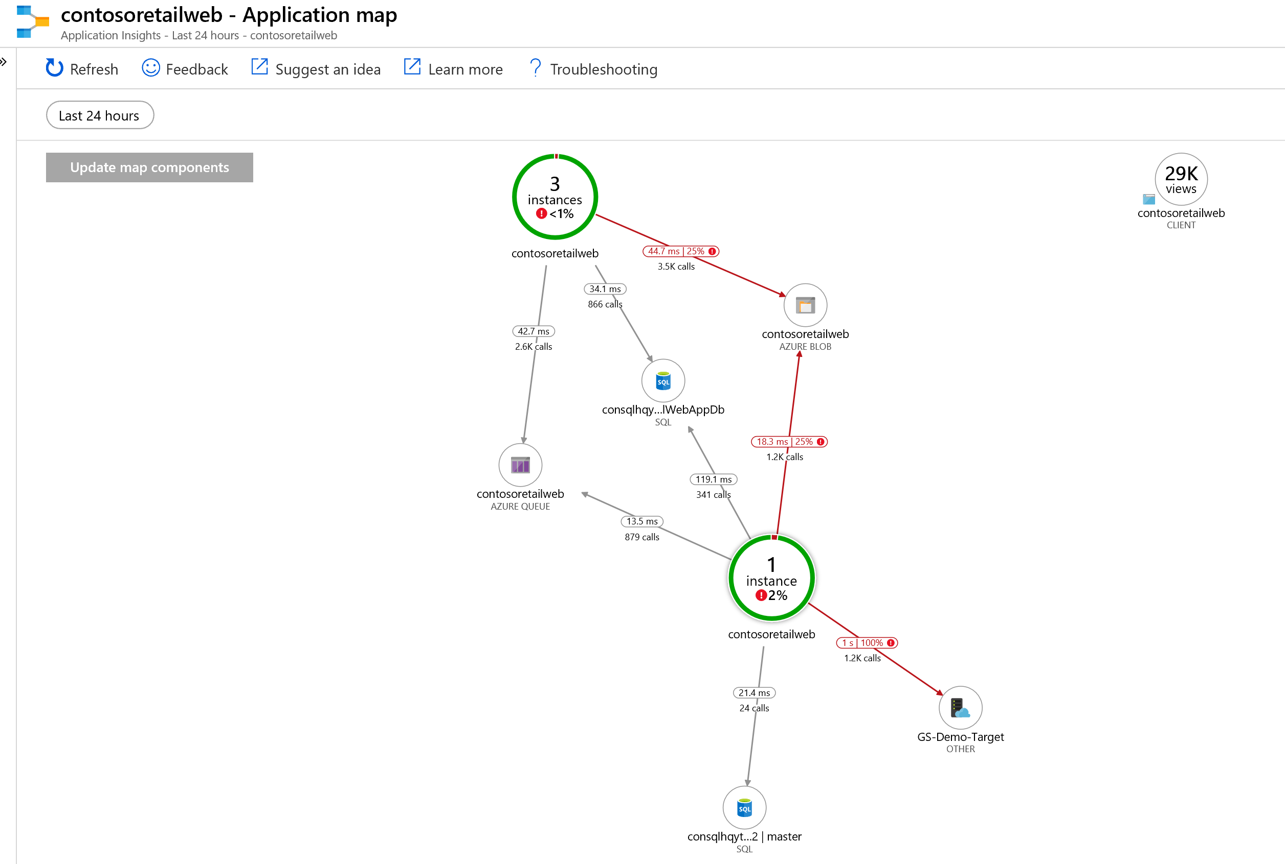
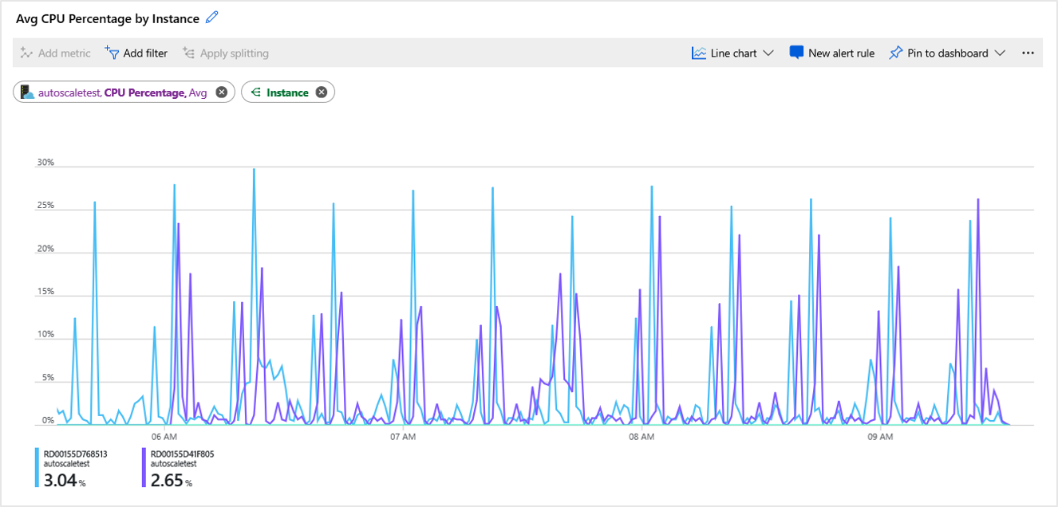
Consuming the Data
Notes:
App Insights Blade in Azure Portal
Application Map
Profiler
Metrics Explorer
Live Metrics
Visual Studio Extensions
Power BI
Continuous Export

Slide 15
Consuming Telemetry in Action
Demo

Slide 16
I have production issues

Slide 17
Reasons for Production Issues
Environment Configuration
Data Exposing Bugs in Code
Scaling Issues
What Else?

Slide 18
Triage Options
Copy Down Production Data to Local
Use Production Staging Environment
Read Logs (IIS, DB Logs, etc)
Attach Debugger to Prod.. NO, STOP, DO NOT PASS GO

Slide 19
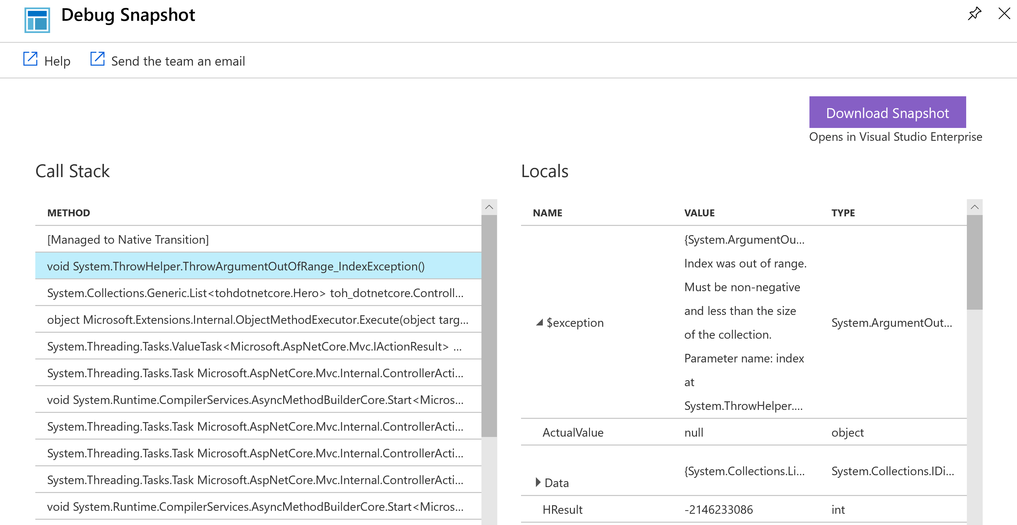
There has to be a better way?
Snapshot Debugger
Full Stack Trace
Locals window at time of Exception
Visual Studio Debugging detached from App

Slide 20
Snapshot Debugger/Exceptions
Demo

Slide 21
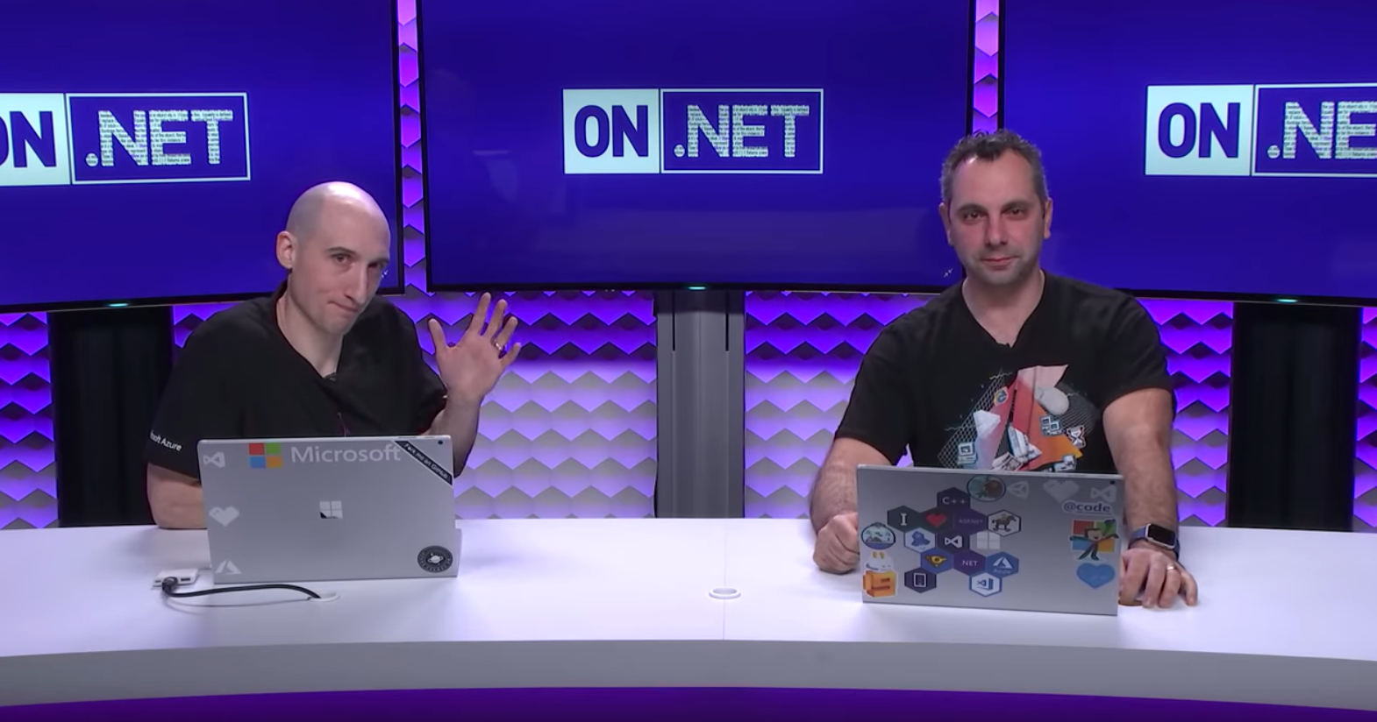
Watch Me on Channel 9!

Slide 22
References
Blog Post on TelemetryInitializers/TelemetryProcessors
http://bit.ly/2GiP1f7
Application Insights Telemetry Extensions Nuget Package
http://bit.ly/2qUC1q9
Application Insights Document Hub
http://bit.ly/2jmnT8y
Log Analytics Language Reference
http://bit.ly/2B4lDKf
Debug snapshots on exceptions in .NET apps
http://bit.ly/2kj0CBd
Application Insights GitHub Repo
http://bit.ly/2j4ciaM
Tour of Heroes Repo
http://bit.ly/2BV0L8i
Thank You! Any Questions?

